Slide 1
How American Homicide Changed Over This Decade
An Exploratory Data Analysis
By Hafsa and Nicole

Slide 2


How do murder rates in 2020 differ from 2010?
Did per capita homicide rates rise this decade? Is there a correlation between population size and murder rates? Together, we will explore state crime statistics from the Federal Bureau of Investigation to answer these questions.

Slide 3
State Homicide Per Capita by Year
Did homicide rates in 2020 increase from 2010 rates (adjusted for population growth)?
Let’s take a look at how per capita rates for each state compared between years:

Slide 4
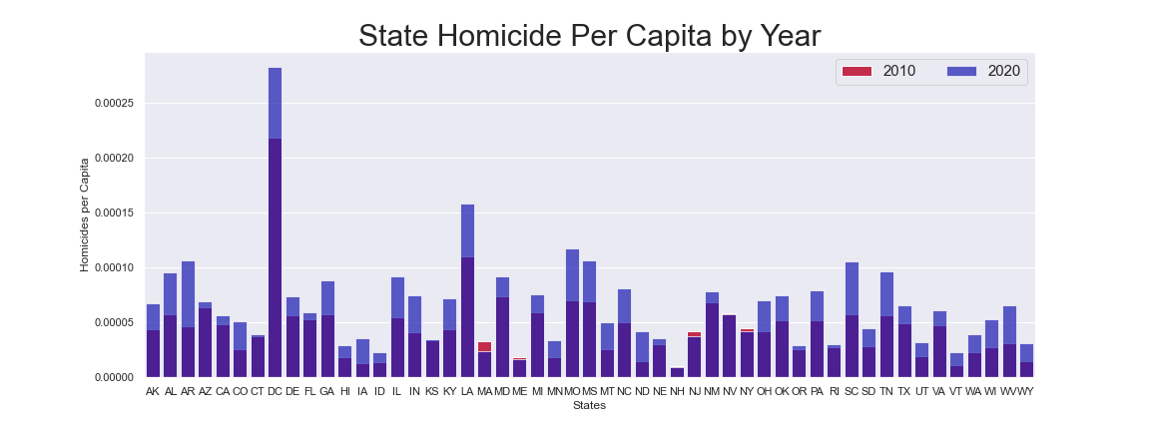
Here you can see that, but for only 3 exceptions, murder rates were higher in 2020 than in 2010 across the entire nation! Important to note: these are PER CAPITA rates, and so are adjusted for population growth.
Notes:
Here you can see that, but for only 3 exceptions, murder rates were higher in 2020 than in 2010 across the entire nation! Important to note: these are PER CAPITA rates, and so are adjusted for population growth.

Slide 5
Homicides per Capita per Population Size
Do murders occur more often when more people live together?
Let’s now examine a depiction of how homicide per capita compares to state population:

Slide 6
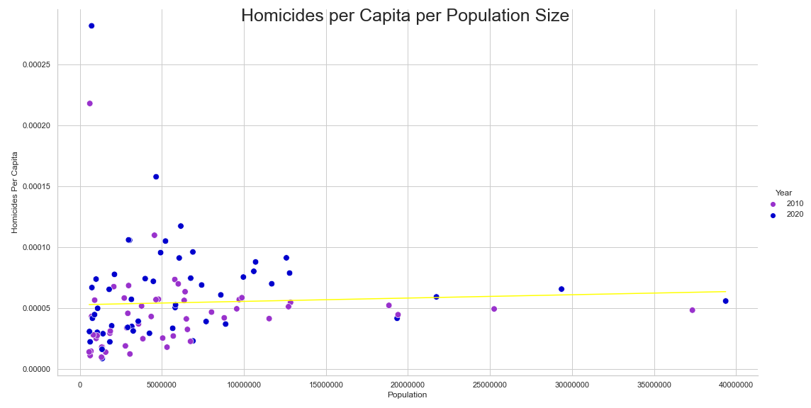
This data shows almost NO correlation between per capita murder rates and state population size. The correlation coefficient calculated by np.corrcoef = 0.04932725. That is less than 5%, and as you can see, there are plenty of outliers

Slide 7
National Homicide Per Capita
Finally, we ask: How did murder rates for the entire country in 2020 compare to a decade prior?
With quarantine measures in effect, we were also curious to see if homicide rates were higher for the year 2020. Let’s see if that is supported or refuted:

Slide 8
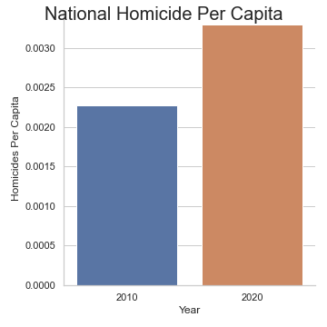
These rates are adjusted for population growth. Therefore, there is a clear increase in homicides between 2020 and 2010. While this data does not indicate why homicide rates jumped last year, the fact that the rates are higher, has been found:
Notes:
These rates are adjusted for population growth. Therefore, there is a clear increase in homicides between 2020 and 2010. While this data does not indicate why homicide rates spiked last year, Hafsa’s hypothesis as been:

Slide 9

Thank you!
Regards, Hafsa & Nicole
Notes:
Thank you! Regards, Hafsa&Nicole

